Slide 1
Agentic Repository Automation for Maintainers
Don Syme
Principal Researcher, GitHub Next
May 2026
Notes:
Note: Put phone on do not disturb, Slack to not notify, Teams closed
Thank you for the introduction, Rahul. Again, my name is Eddie Aftandilian. I’m a principal researcher in GitHub Next, and today I’ll be sharing some lessons that we have learned from building GitHub Copilots.

Slide 2
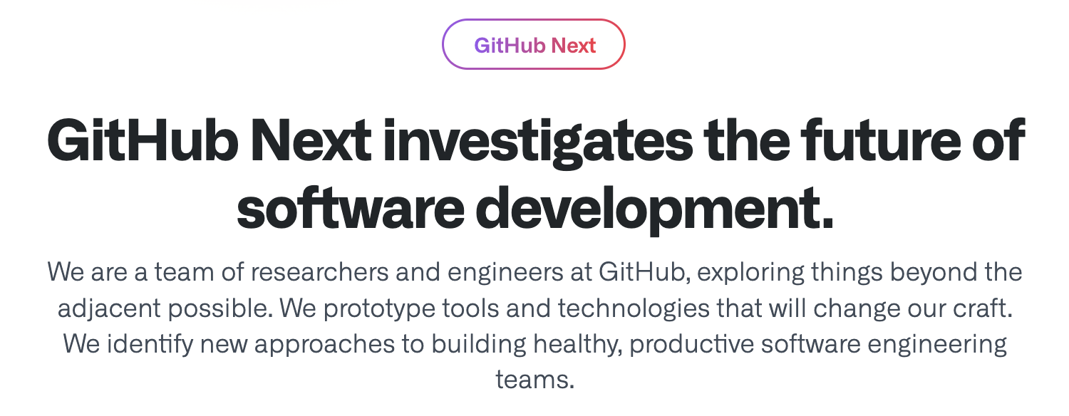
GitHub Next
Research, Build, Balance, Ship, Learn

Slide 3

We live in the most incredible of times
AI and traditional dev tools make us all magicians when it comes to code
Everything is changing, yet continuity is there too
The maintainer is usually the victim of AI. What if the maintainer is given the power to choose what AI automation gets used?
Notes:
AI developer tools are changing the way we write software.
GitHub Copilot was one of the first such tools. It launched as a technical preview (essentially a closed beta) in June 2021. Today it has 1.8M paying users, and 50% of those users’ code is written by Copilot. Other companies such as Google report similar proportions of AI-generated code for their comparable AI code completion tools.
This will only increase as the next generation of tools comes online. These are tools that approach the problem at a higher level – for example, completing an entire development task as opposed to completing a line of code or a function
Copilot Workspace, Devin, Cursor, et al.

Slide 4

We live in the most incredible of times
AI and traditional dev tools make us all magicians when it comes to code
Everything is changing, yet continuity is there too
The maintainer is usually the victim of AI. What if the maintainer is given the power to choose what AI automation gets used?
Notes:
AI developer tools are changing the way we write software.
GitHub Copilot was one of the first such tools. It launched as a technical preview (essentially a closed beta) in June 2021. Today it has 1.8M paying users, and 50% of those users’ code is written by Copilot. Other companies such as Google report similar proportions of AI-generated code for their comparable AI code completion tools.
This will only increase as the next generation of tools comes online. These are tools that approach the problem at a higher level – for example, completing an entire development task as opposed to completing a line of code or a function
Copilot Workspace, Devin, Cursor, et al.

Slide 5
Continuous AI

Slide 6
Theme 5: Continuous AI
Continuous Integration
Continuous Deployment
Continuous AI
https://githubnext.com/projects/continuous-ai/
Notes:
The original GitHub Copilot completes code in your editor
You have to accept small bits
You have to move your cursor around
You still have to type quite a lot
Copilot has to infer what you are trying to do
Can we switch POV to whole task, whole change, whole repository
While keeping the key learning of Copilot: repeated AI-user alignment

Slide 7
Continuous AI
implemented by
Agentic Workflows

Slide 8



GitHub Agentic Workflows
Agentic human processes powered GitHub.
Automation
Workflows executed via GitHub Actions written in natural language.
Automation
+
Automation
Isolated sandboxes with scoped permissions and network control.
Safety
+
Automation
Agents interpret intent & operate on context across models. Copilot CLI · Claude · Codex · Gemini
Reasoning

Slide 9
Example - Weekly Researcher
---
on:
schedule:
- cron: "0 9 * * 1" # Every week, 9AM UTC, Monday
workflow_dispatch:
safe-outputs:
create-issue:
tools: web-search: ---
# Agentic Weekly Researcher (Ruby)
Do a deep research investigation in ${{ github.repository }} repository, and the related industry in general.
- Read selections of the latest code, issues and PRs for this repo.
- Read latest trends and news from the software industry news source on the Web.
Create a new GitHub issue containing a markdown report with interesting news about the area related to this software project, related products and competitive analysis, related research papers, new ideas, market opportunities, business analysis, enjoyable anecdotes.
> NOTE: Include a link like this at the end of the report:
```
> AI-generated content by ${{ github.workflow }}, may contain mistakes.
```
Triggers
Safe output specs
NL programming = deliberate ambiguity = genuinely useful ambiguity
Tools
Actions-familiar
Assumes GitHub
Self-reporting

Slide 10
Example - Issue Triage
---
on:
issues:
types: [opened, reopened]
safe-outputs:
add-comment:
---
# Agentic Issue Triage
Your task is to analyze issue #${{ github.event.issue.number }} and perform some initial triage tasks related to that issue.
Analyze the issue content. Write notes, ideas, nudges, resource links, debugging strategies and/or reproduction steps for the team to consider relevant to the issue. Select appropriate labels already used in the repository and apply them to the issue.
Finalize an output report with your analysis and add it as an issue comment to the issue.
> NOTE: Include a link like this at the end of your issue comment:
```markdown
> AI-generated content by ${{ github.workflow }}, may contain mistakes.
```

Slide 11
Agentic Workflows - Getting Started
Samples
gh extension install github/gh-aw gh aw add githubnext/agentics/daily-test-improver <secret+commit+push> gh aw run daily-test-improver --repeat 30

Slide 12
Agentic Workflows - Safety, Safety, Safety
Execution is VM-sandboxed (GitHub Actions VMs)
Overall permissions are minimized
Agentic steps run essentially read-only
All outputs are “in the intended channel” (“safe outputs”)
blast radius greatly reduced
checked by AI for safety
human oversight guaranteed
Outgoing network is firewalled and controlled

Slide 13
Continuous AI
implemented by
Agentic Workflows
enables
Agent Zoo

Slide 14
Continuous AI
implemented by
Agentic Workflows
enables
Continuous Engineering

Slide 15
Continuous AI
implemented by
Agentic Workflows
enables
Automated Maintenance Assistance

Slide 16
Continuous AI
implemented by
Agentic Workflows
enables
Repository Velocity

Slide 17
BREAKOUT

Slide 18
Q1 – What are your key goals in your repositories? Sample keywords: quality, backlog, stability, maintenance, community, velocity, adoption, contribution, performance, simplicity, leadership, human visibility, being a part of something, education, helping others, making money, raising money

Slide 19
Q2 – What would you, your co-maintainers and community think about automated AI presence in your repo? Hint: “they would utterly hate it” is a valid response

Slide 20
Q3 – Which of these (if any) would you or your community choose to use? AI workflows under your control that automatically: - label issues? - label or close low quality of spam issues - label or close low quality or spam PRs - respond to long legacy issues (> 2Yr) with its “point of view” or analysis - create pull requests for long legacy issues - propose engineering improvements via new issues or dicussions - give engineering advice to the maintainer through issues or back channels - propose documentation updates - propose forward code simplifications and refactorings - propose forward test improvements - propose forward performance improvements and benchmarks - other - discuss

Slide 21
Q4 – Brainstorm on quality goals for AI to contribute towards What quality goals are you not able to make progress on? Simplicity? Test coverage? Integration tests? Test performance? Code performance? Documentation? Accessibility?

